Slide 1
Software Project Management
Processes and Organization
Dr. Seemab Latif
Lecture No. 2
1st March, 2011

Slide 2
Today
PMI Fundamentals
Project Organization
Project Selection
Project Portfolio Management
Procurement Management
Statement of Work (SOW)
Project Charter
Notes:
No lab today
More lab in later term

Slide 3
Lecture 1 Review
Project and Process
4 Project Dimensions
People, process, product, technology
Approaches to SPM
Traditional, critical chain , event chain, extreme programming, PRINCE2
Trade-off Triangle
Process. One size not fit all.
36 Classic Mistakes

Slide 4
Trade-off Triangle
Know which of these are fixed & variable for every project

Slide 5
Project Phases A.K.A.

Slide 6
Project Success Rates
The 2001 Standish Group Report Showed Decided Improvement in IT Project Success Rates From the 1995
Time overruns: decreased to 63% compared to 222%
Cost overruns were down to 45% compared to 189%
Required features were up to 67% compared to 61%
78,000 U.S. projects were successful vs. to 28,000
28% of IT projects succeeded compared to 16%
Why the Improvements?
Avg. cost reduced by half
Better tools for monitoring and control
More skilled PM’s, more process, more user involvement
And “The fact that there are processes is significant in itself.“

Slide 7
Why Do Projects Succeed?
How to identify a project’s success potential
What metrics could you look at?
Project size
Project duration
Project team size
Case study

Slide 8
Why Do Projects Succeed?
Executive support
User involvement
Experience project manager
Clear business objectives
Minimized scope
Standard software infrastructure
Firm basic requirements
Formal methodology
Reliable estimates
Standish Group “CHAOS 2001: A Recipe for Success”

Slide 9
Why Executive Support?
Top management can help to:
Secure adequate resources
Get approval for unique project needs in a timely manner
Receive cooperation from people throughout the organization
Provide leadership guidance

Slide 10
Stakeholder Triad
1. Function Representative
The ‘business person’
Or SME: Subject Matter Expert
2. Executive Sponsor
Project’s visionary & champion
Also the ‘General’, ‘Fall Guy’, and ‘Minesweeper’
Not the PM, ‘Santa Claus’, or the ‘Tech Guy’
3. Project Manager
The ‘key player’
Must be ‘multi-lingual’

Slide 11
15 PM Job Functions
Define scope of project
Identify stakeholders, decision-makers, and escalation procedures
Develop detailed task list (work breakdown structures)
Estimate time requirements
Develop initial project management flow chart
Identify required resources and budget
Evaluate project requirements
Identify and evaluate risks
Prepare contingency plan
Identify interdependencies
Identify and track critical milestones
Participate in project phase review
Secure needed resources
Manage the change control process
Report project status
*Northwest Center for Emerging Technologies, "Building a Foundation for Tomorrow: Skills Standards for Information Technology,"Belleview, WA, 1999

Slide 12
PMBOK
Structures PM by
A) Processes
B) Knowledge Areas
Processes. 2 types
1. PM processes: describing and organizing the work of the project
2. Product-oriented processes: specifying and building the project’s product

Slide 13
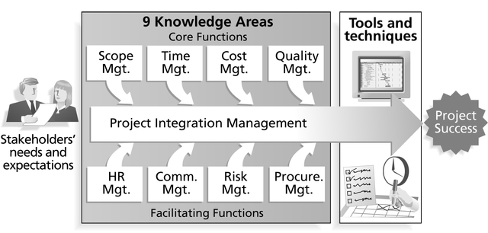
PMI Framework
Source: Project Management Institute

Slide 14
The 5 PMI Process Groups
1. Initiating
2. Planning
3. Executing
4. Controlling
5. Closing
Note: these can be repeated for each phase
Each process is described by:
Inputs
Tools & Techniques
Outputs
Notes:
projects are composed of processes

Slide 15
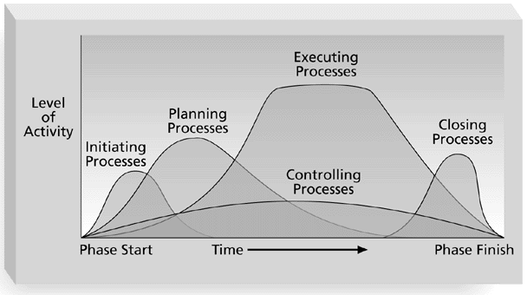
PMI Process Groups
Source: Project Management Institute

Slide 16
PMI: Process Links

Slide 17
PMI Phase Interactions

Slide 18
PMI: Initiating Process
Inputs
Product Description
Strategic plan
Project Selection Criteria
Historical Information
Outputs
Project charter
Project Manager assigned
Constraints
Assumptions

Slide 19
PMI: Planning Process
Devising and maintaining a workable scheme to accomplish the business need that the project was undertaken to address
Scope Planning
Scope Definition
Activity Definition
Activity Sequencing
Activity Duration Estimating
Resource Planning
Cost Estimating
Cost Budgeting
Risk Planning
Schedule Development
Quality Planning
Communications Planning
Organization Planning
Staff Acquisition
Procurement Planning
Project Plan Development

Slide 20
PMI: Executing Process
Coordinating people and other resources to carry out the plan
Project Plan Execution
Scope Verification
Quality Assurance
Team Development
Information Distribution
Solicitation
Source Selection
Contract Administration

Slide 21
PMI: Controlling Process
Ensuring that project objectives are met by monitoring and measuring progress and taking corrective measures when necessary
Overall Change Control
Scope Change Control
Schedule Control
Cost Control
Quality Control
Performance Reporting
Risk Response Control

Slide 22
PMI: Closing Process
Formalizing acceptance of the project or phase and bringing it to an orderly end
Administrative Closure
Contract Close-out

Slide 23
PMI Knowledge Areas

Slide 24
Importance of Phases
Define your management review points
“Phase exits” or “kill points”
Ensure continued alignment with goals
Form of Validation & Verification (V&V)

Slide 25
Understanding Organizations
Structural frame: Focuses on roles and responsibilities, coordination and control. Organization charts help define this frame.
Human resources frame: Focuses on providing harmony between needs of the organization and needs of people.
Political frame: Assumes organizations are coalitions composed of varied individuals and interest groups. Conflict and power are key issues.
Symbolic frame: Focuses on symbols and meanings related to events. Culture is important.

Slide 26
Organizational Structures
Functional
Engineering, Marketing, Design, etc
P&L from production
Project
Project A, Project B
Income from projects
PM has P&L responsibility
Matrix
Functional and Project based
Program Mgmt. Model
Shorter cycles, need for rapid development process

Slide 27
Functional Organization
Pros
Clear definition of authority
Eliminates duplication
Encourages specialization
Clear career paths
Cons
“Walls”: can lack customer orientation
“Silos” create longer decisions cycles
Conflicts across functional areas
Project leaders have little power

Slide 28
Project Organization
Pros
Unity of command
Effective inter-project communication
Cons
Duplication of facilities
Career path
Examples: defense avionics, construction

Slide 29
Matrix Organization
Pros
Project integration across functional lines
Efficient use of resources
Retains functional teams
Cons
Two bosses for personnel
Complexity
Resource & priority conflicts

Slide 30
Matrix Forms
Weak, Strong, Balanced
Degree of relative power
Weak: functional-centric
Strong: project-centric

Slide 31
Organizational Structure Influences on Projects
PMBOK Guide, 2000, p. 19

Slide 32
Organizational Impact
Form can greatly impact your role
Determine what skills you’ll need from which functions
The new “Project Office”
A) As centralized project management
B) As coach and info. office to project teams
The “Enterprise PMO” (EMPO)

Slide 33
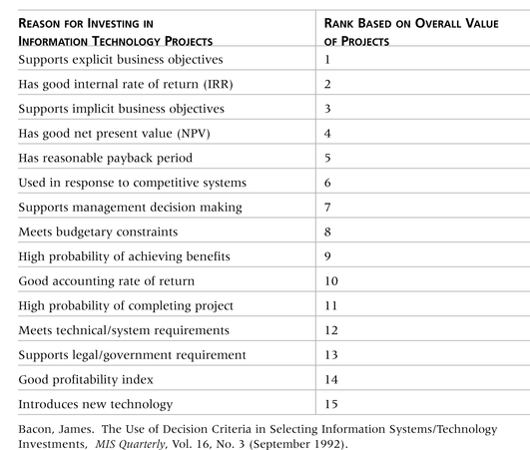
Why Firms Invest in IT

Slide 34
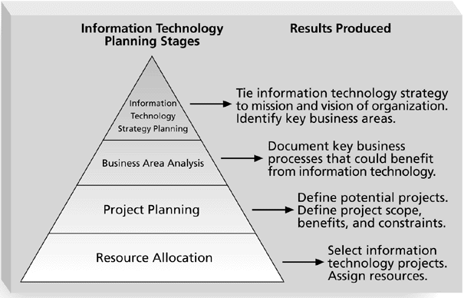
IT Planning Process

Slide 35
Methods for Selecting Projects
There are usually (always?) more projects than available time and resources to implement them
Therefore: It is important to follow a logical process for selecting IT projects to work on
Methods include
Focusing on broad needs
Categorizing projects
Financial methods
Weighted scoring models

Slide 36
Broad Organizational Needs
It is often difficult to provide strong justification for many IT projects, but everyone agrees they have a high value
“It is better to measure gold roughly than to count pennies precisely”
Three important criteria for projects:
There is a need for the project
There are funds available
There’s a strong will to make the project succeed

Slide 37
Categorizing IT Projects
One categorization: whether project addresses
a problem
an opportunity
a directive
Another: how long it will take & when it is needed
Another: overall priority of the project

